Slide 1


INTELLIGENT WEB-BASED MENTORING SYSTEM FOR HIGHER EDUCATION
NAME OF STUDENTS -
Sejal Jadhav
Chirag Sharma
Dhruv L
SUPERVISOR NAME -
Prof. Shubham Mahajan

Slide 2

CONTENT
INTRODUCTION
LITERATURE REVIEW
RESEARCH GAPS
OBJECTIVES
METHODOLOGY
RESULTS AND DISCUSSION
CONCLUSION
FUTURE SCOPE
REFERENCES

Slide 3

INTRODUCTION
Students enrolling for diploma /Diploma pass-out student face problem in admission process.
Selecting college for higher education is very difficult.
This Idea focuses on ways to support student in admission process, decision making using data mining techniques to select colleges.
Determine the relationship between college cut-off criteria and student aggregate in diploma/previous education years.
Finding valid and reliable cut-off criteria is very important to select colleges for higher education.

Slide 4
LITERATURE SURVEY
PAPER PARAMETER | PAPER [1] | PAPER [2] | PAPER [3] | PAPER [4]
PAPER NAME | The current landscape of learning analytics in higher education. (2018) | A Systematic Review on Educational Data Mining.(2017) | Enhancing learners’ experience in e-learning based scenarios using Intelligent Tutoring Systems and Learning Analytics: First results from a perception survey.(2017) | Learning Analytics Methods, Benefits, and Challenges in Higher Education: A Systematic Literature Review.(2019)
AUTHOR | O. Viberg, M. Hatakka, O. Bälter, and A. Mavroudi. | A.Dutt, M. A. Ismail, and T. Herawan. | R. M. M. F. Luis, M. Llamas-Nistal, and M. J. F. Iglesias. | J. T. Avella, M. Kebritchi, S. G. Nunn, and T. Kanai.
SUMMARY | EDM is an emerging interdisciplinary research area that deals with the development of methods to explore data originating in an educational context. | Educational institutions compile and store huge volumes of data, such as student enrolment and attendance records, as well as their examination results. | E-learning students tend to get jaded and easily dropout from online courses. | Learning analytics is a significant area of technology-enhanced learning that has emerged during the last decade.

Slide 5

In Existing system, it does not have facility to analysis and predict the college.
CAP(Centralized Admission Process) round process is run on the basis of cut-off of the college and this cut-off analysis is not easy for student and time consuming as it has to be done manually.
Cut-off list is also not easily available on internet.
Student search random colleges for the CAP round process not having any information about the colleges and college cut-off of previous years.
With the endless increase in the strength of the students and the number of engineering institutions it is very much required.
RESEARCH GAP

Slide 6

OBJECTIVE / PROPOSED SYSTEM
In Proposed system,it can analyse and give you list of college to select from.
There are 3 modules created to avoid confusion and create a user friendly UI for students and colleges both.
In this system, there is simple login system to login and logout for all the three modules.
Helps find details about college and also their cut-off criteria easily.

Slide 7
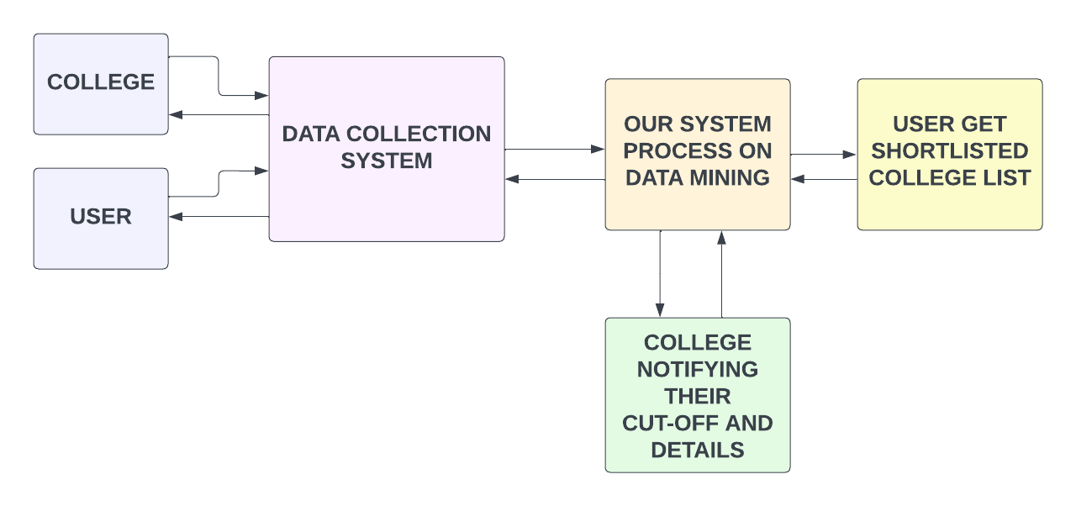
METHODOLOGY : FLOW DIAGRAM

Slide 8
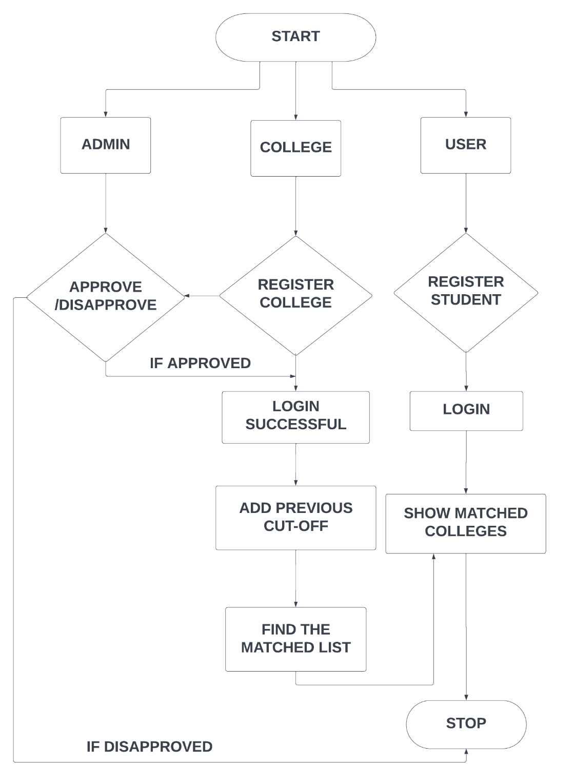
METHODOLOGY : FLOWCHART

Slide 9
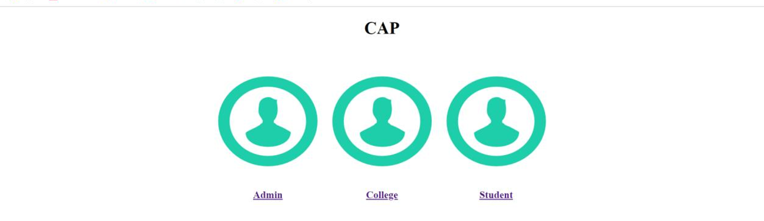
RESULTS : HOME SCREEN

Slide 10
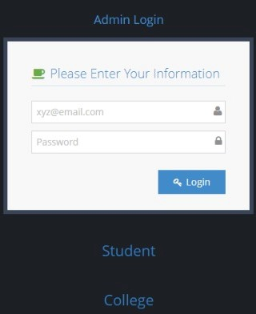
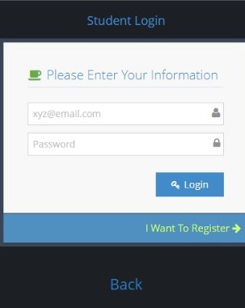
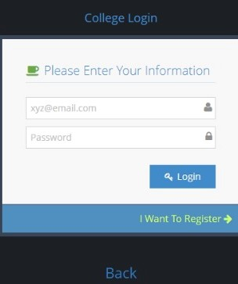
RESULTS : LOGIN PAGES

Slide 11
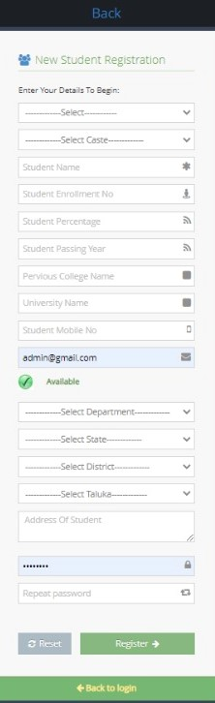
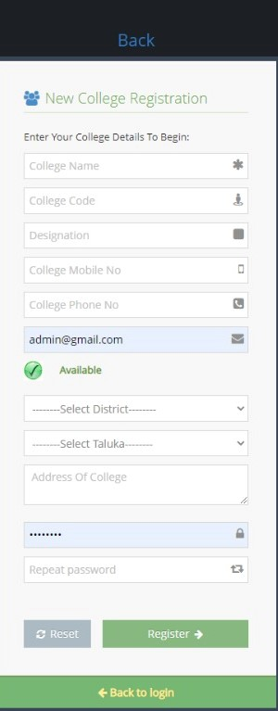
RESULTS
REGISTRATION PAGES

Slide 12
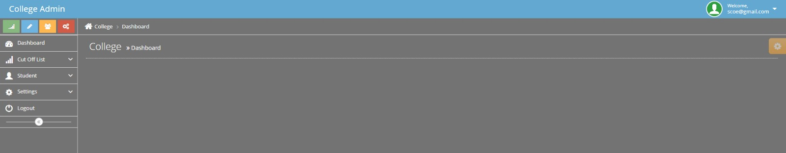
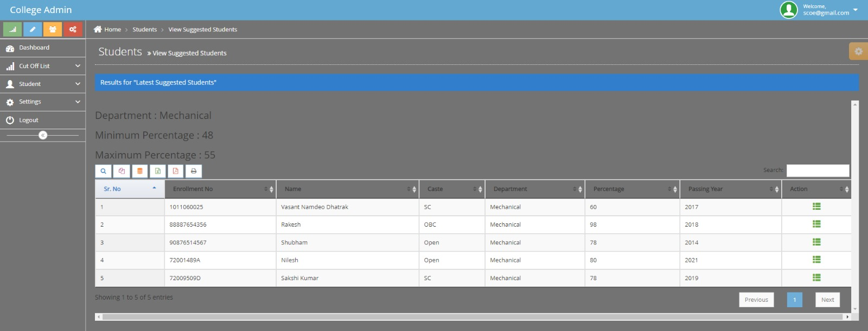
RESULTS : DASHBOARD

Slide 13
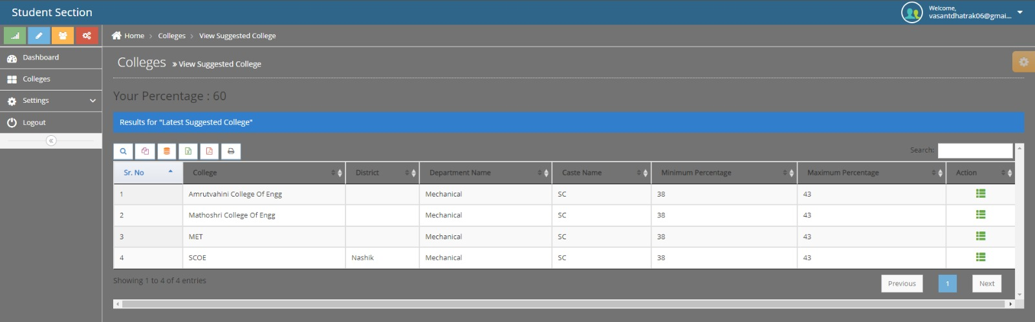
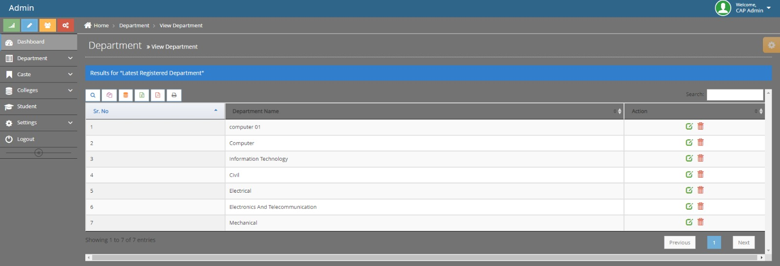
RESULTS : DASHBOARD

Slide 14

FUTURE SCOPE
Develop android application.
Integrate it for other educational fields as well.
Making it offline.
Additional features like chatbot for better assistance.

Slide 15

CONCLUSION
Aim - to help/ support students in making good decisions while selecting colleges/universities.
Our system focuses on building systematic & user friendly communication system between universities & students.
Students get clear and correct picture about their ranking, colleges /university and career choices.

Slide 16

[1] A. Dashputre, D. Shetye, A. Sonawane, P Mangalkar “A web-based application for tutoring support in higher education using educational data mining” Vol-8 Issue-2 2022.
[2] Hanan Abdullah Mengash, “Using Data Mining Techniques to Predict Student Performance to Support Decision Making in University Admission Systems” 30 March 2020, vol8 2020.
[3] H. Aldowah, H. Al-Samarraie, and W. M. Fauzy, ‘‘Educational data mining and learning analytics for 21st century higher education: A review and synthesis,’’ Telematics Informat., vol. 37, pp. 13–49, Apr. 2019.
[4] A. M. Shahiri, W. Husain, and N. A. Rashid, ‘‘A review on predicting Student’s performance using data mining techniques’’ Procedia Computer. Sci., vol. 72, pp. 414– 422, Jan. 2015.
[5] Prasanna B, C B Akki, “Dynamic Multi-Keyword Ranked Searchable Security Algorithm Using CRSA and B-Tree”, Vol. 6 (1), 2015
REFERENCE

